Slide 1











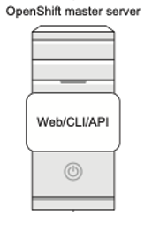



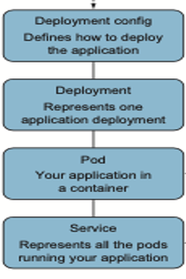








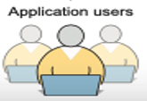
AppW Archive Data Traffic Flow and Authentication
Citizens Internal Network
Cloud
VPC
Consumer account
Security Account
Shared Services
Subnet 2
Subnet 1
CI/CD Pipeline
Jump Server
AWS Services
Routing Layer
with Load balancer
PaaS OpenShift Cluster
Citizens Internal Network

